Slide 1
Records identified from databases
Scopus (n =205)
Web Of Science (n = 173)
Duplicate records removed (n = 114)
Records were marked as ineligible by bibliometrix (n = 110)
Records were removed by a human (n = 4)
Records identified from:
Citations of relevant
Scopus (n = 18)
Web Of Science (n =10)
Others sources (n =9)
Identification
Records screened with titles, abstracts and filters (n = 185)
Records excluded
(n = 64)
Screening
Reports assessed for eligibility (n = 202)
Reports excluded (n = 59)
Lacked focus on methods (n = 48)
Used commercial software (n = 5)
Methods not clearly described (n = 6)
Elegibility
Papers and new studies included (n= 62 + 37)
Included
Full-text articles included in review (n = 99)

Slide 2








Data Selection
Electrocardiographic Imaging (ECGI) Reconstruction
Records identified:
Scopus (n=205)
Web Of Science (n=173)
The search strategy was based on the PRISMA statement
Full-text included in review
(n = 99)
2. Direct problem
Experimental Approaches
Numerical Methods
Datasets
Study Acquired Data
Other Study Data
Boundary Element Method
Finite Element Method
Method of Fundamental Solutions
Hybrid Methods
Experimental settings
Ex vivo - Torso-Tank
In vivo - Animal Trials
In vivo - Clinical Trials
In silico
3. Inverse problem
4. Feature Extraction
Regularization Techniques
Approaches
Classic regularization
Stochastic
Spatial–temporal
Time–frequency
Physiology-based
Machine learning
Extracellular potential-based models
Transmembrane voltage-based models
Activation/recovery-based reconstruction
Transmural studies
Location of stimulation sites
Fibrosis and scarring/ischemic regions
Frequency domain analysis
Regularization parameter
L-curve, L-surface, U-curve
Zero-crossing
Discrete Picard condition
Morozov discrepancy
Genetic algorithm

Slide 3


Geometry (Nodes & faces)
Architecture PhysMixFormer1D
Inputs
Gauge Projection
Positional Encoding
Geometry & Priors
Reshape / Permutation
Multi-Scale Inception
Chebyshev Bases
34 Baselines (CNN, RNN/GRU/LSTM,. transformer, hybrid, and MLP) + 1 New Method PhysMixFormer1D
Temporal Transformer
Gating
Data Selection
Fidelity (RMSE, PCC, SC) , cost (parameters, MACs) and Explainability
Filter: Savitzky–Golay
QRS Detection: Pan–Tompkins
Preprocessing
Auckland, Bordeaux, Utah
Experimental Framework
Validation metrics
Residual Fusion
Reshape (Projection)
Gauge Projection
Outputs
Composite Loss
Regularization
Physics consistency loss

Slide 4
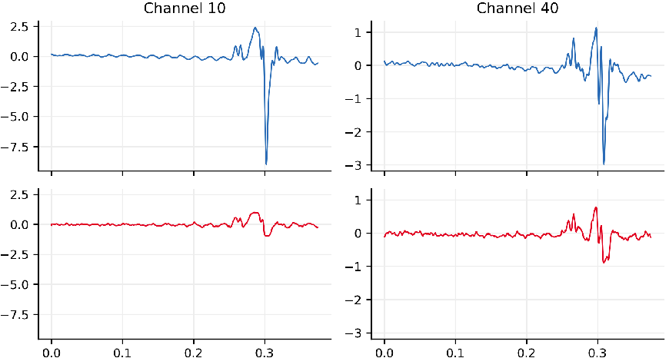
Inputs
Reshape / Permutation
—- reconstructed HSPMs
—- reference HSPMs
1D feature extractor
CNN, RNN/GRU/LSTM, attention/transformer, hybrid, and MLP
Filter: Savitzky–Golay
QRS Detection: Pan–Tompkins
Fidelity (RMSE, PCC, SC) and cost (parameters, MACs)
Data Selection
Unified 1D ECGI Model
Auckland, Bordeaux, Utah
Preprocessing
Validation metrics
Hyperparameter Space
Reshape (Projection)
Outputs

